Slide 1

Macroeconomics II
Lecture 9
Sustainable development
Limits to growth

Slide 2
Theoretical Lecture 9
Limits to growth
Sustainable development
Concepts of sustainability
Energy and economic and social impacts
Social vs economic sustainability
Limits to growth
Readings:
Diamond, Jared (2005), Collapse, Penguin, London (there is a Portuguese translation)
Core (in Aquila)

Slide 3
Recap:
What we discussed: models and growth theories (Adam Smith and classical economics, the Keynesian type of model by Harrod-Domar, the neoclassical models of Solow, AK and Romer)
Next chapter: making development (what to do, how to do, the economic, social and environmental problems)
Today: limits to growth

Slide 4
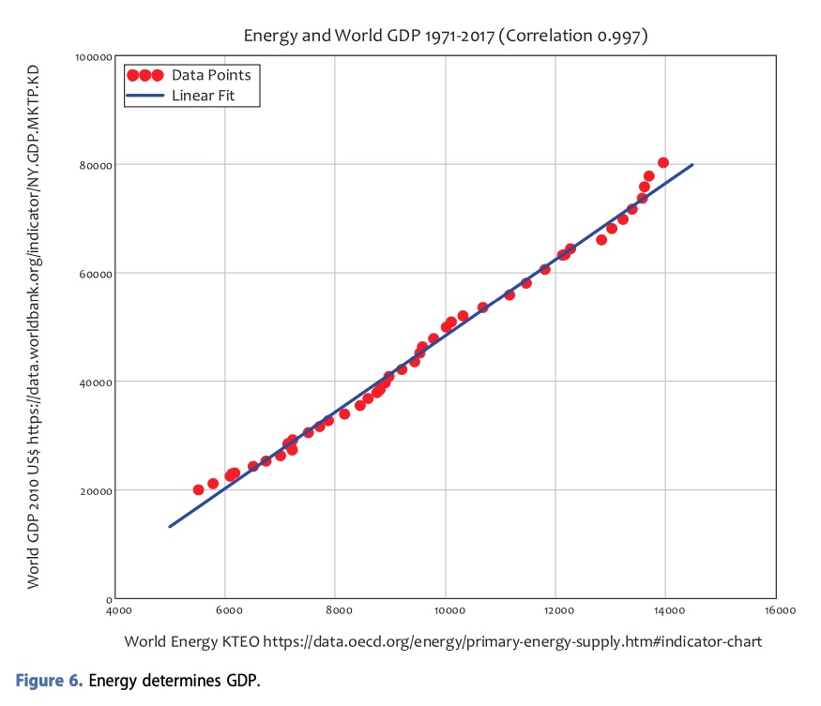
The economic problem:
GDP growth requires more energy

Slide 5
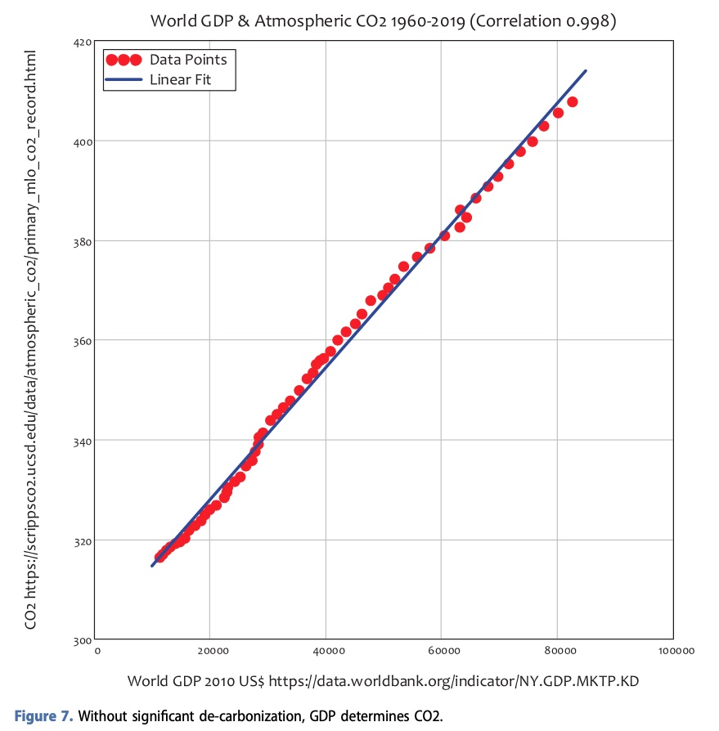
But energy is pollution?
GDP growth means more CO₂?

Slide 6
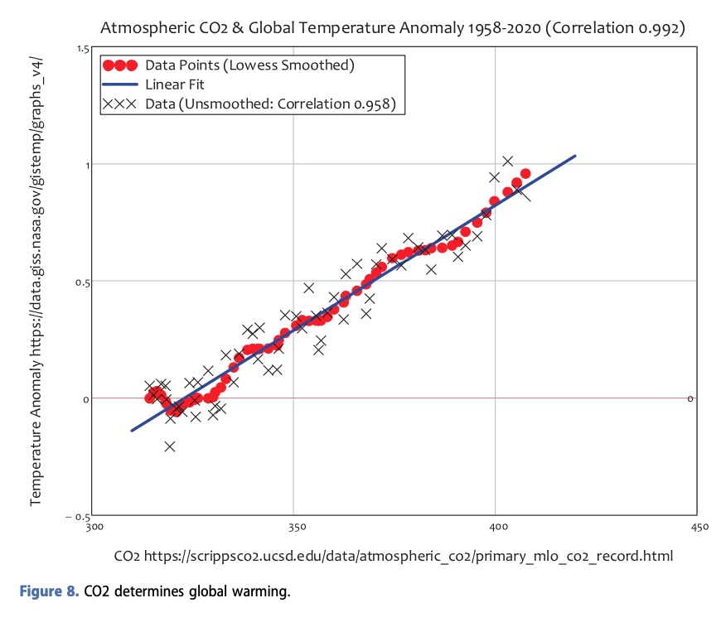
CO2 and temperature anomalies

Slide 7
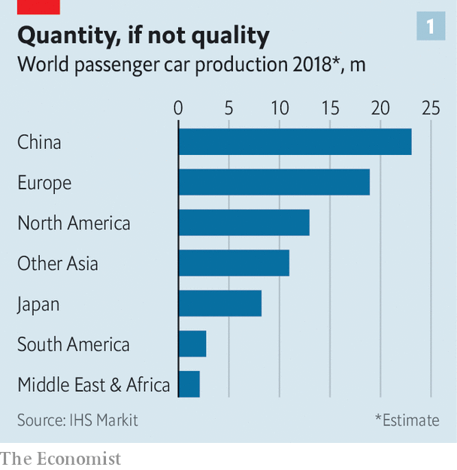
Is this sustainable?

Slide 8
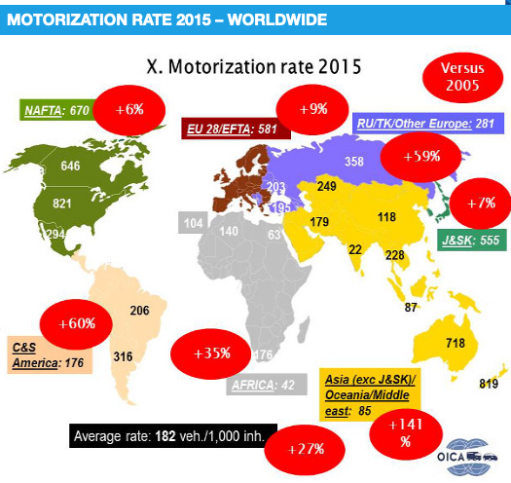
Quite difficult, right?

Slide 9
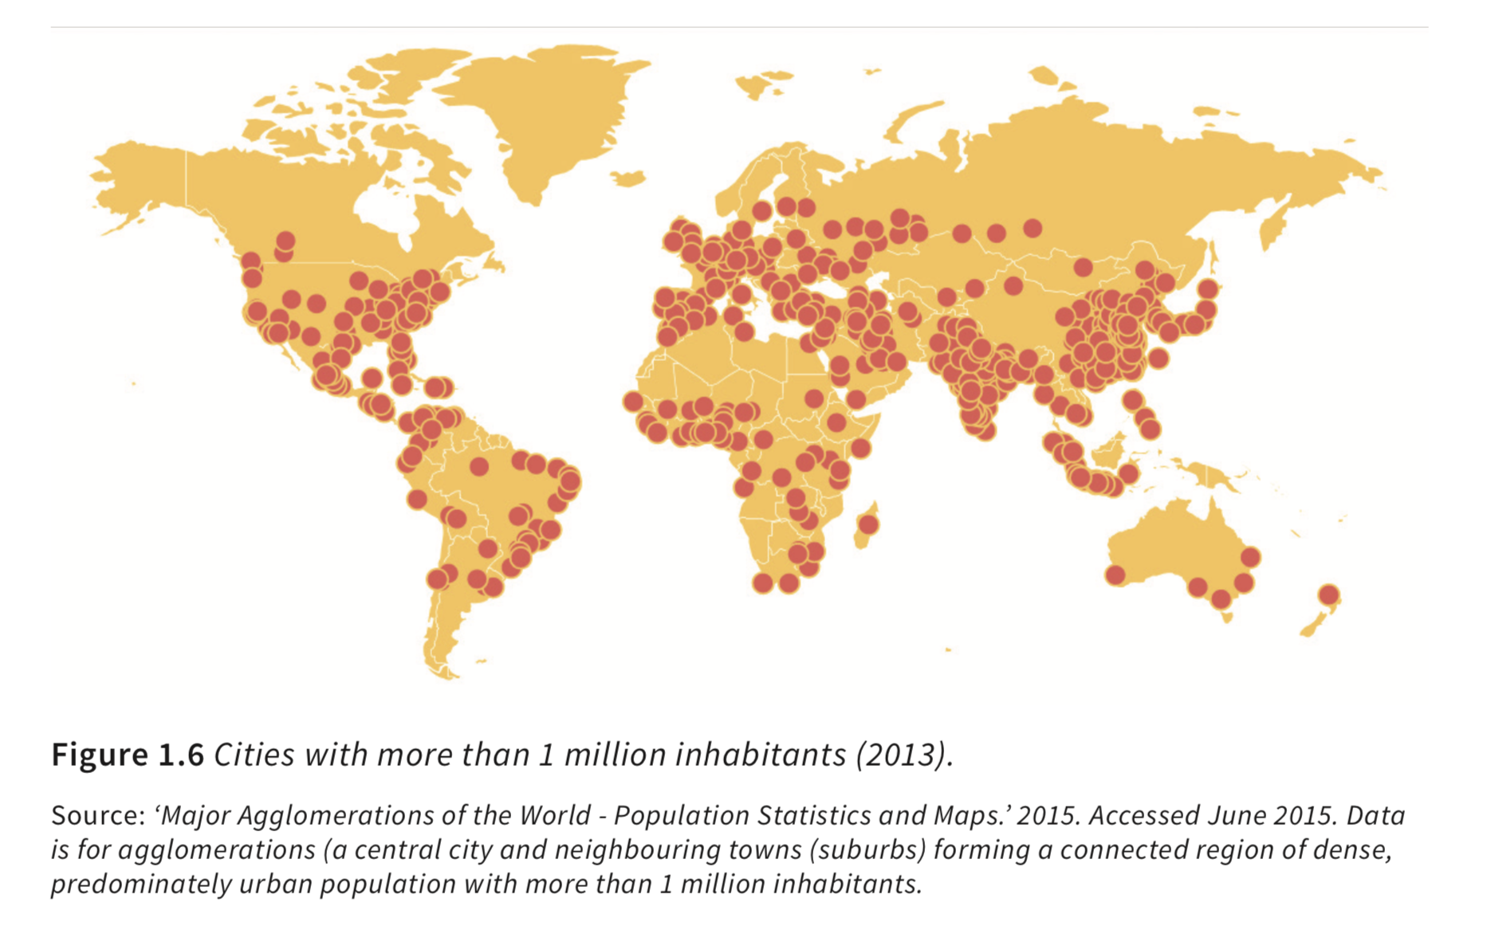
Overcrowded cities

Slide 10
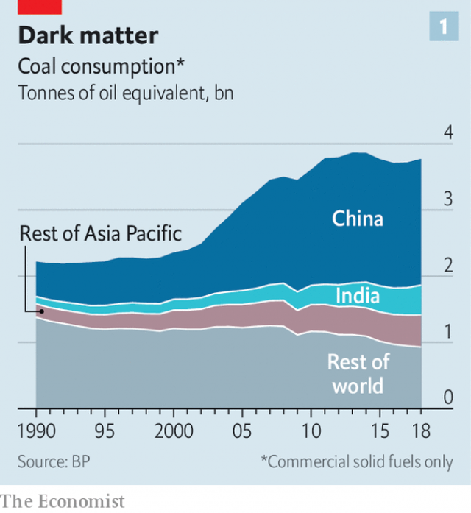
Sustainability? Coal consumption

Slide 11
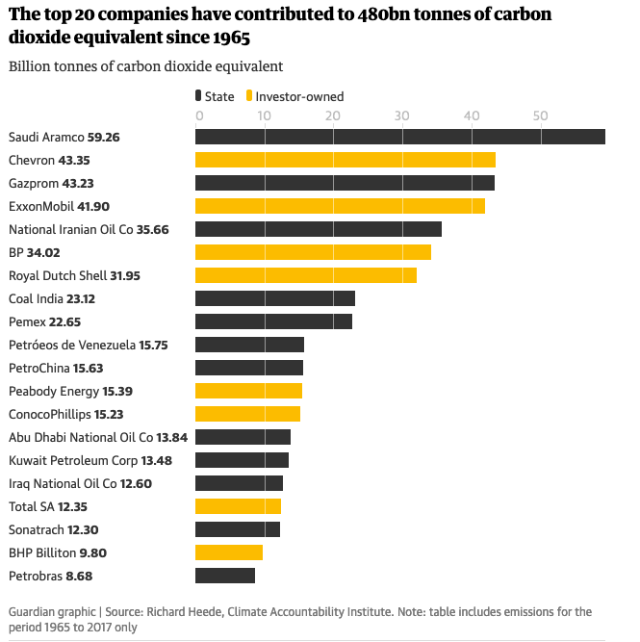
Companies and global emissions

Slide 12
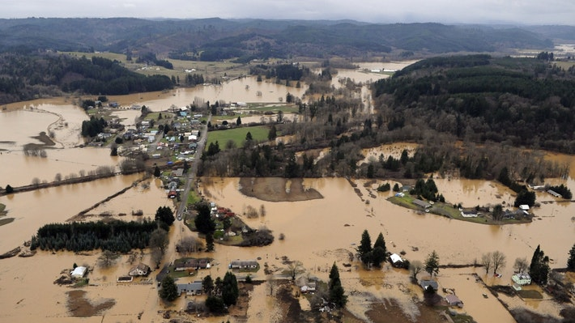

Slide 13
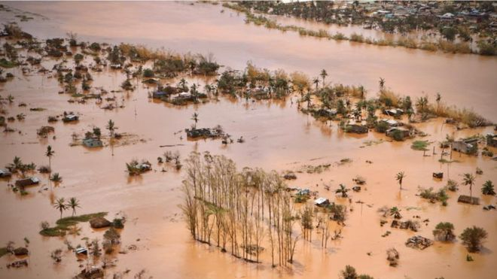

Slide 14
Limits to growth 1
Society, environment and climate change

Slide 15
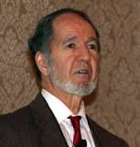

Jared Diamond
(1937-…)
University of California
How do societies survive and adapt?
How and why do they fail?
Climate change
Environment, agriculture, water and other resources
Social organization, trade, war

Slide 16
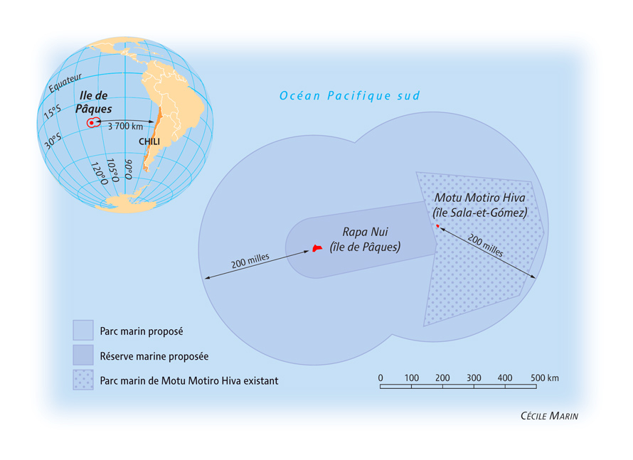
Ecological catastrophe or human catastrophe?
The case of the Easter Island

Slide 17
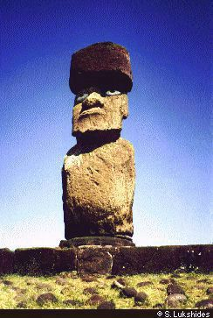
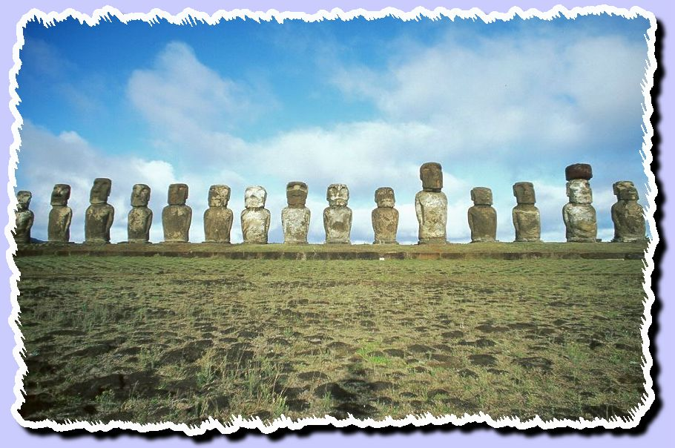
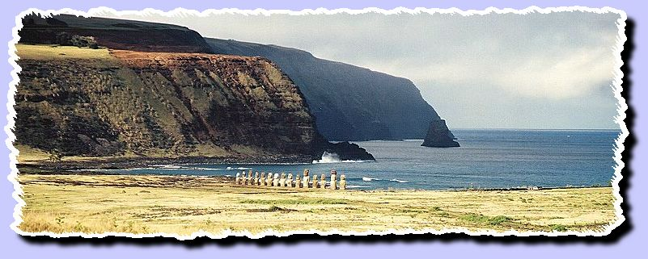
Easter Island statues: who did and why?

Slide 18
According to Diamond (but some disagree), it was mainly an ecological catastrophe: the statues were build for centuries as exhibition of power, but this exhausted the resources (trees for ropes and building tools).
Then, the impoverished populations destroyed the statues and only a few remained at their sites.
Another explanation: diseases contaminated by the Dutch sailors finding the island in the 18th century.
Why did this society collapse?

Slide 19
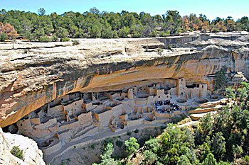
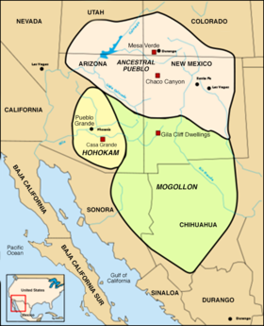
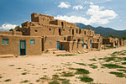
The case of the Anasazi
in what is now Utah, Colorado, Arizona, New Mexico
Approx. 500-1350 our era

Slide 20
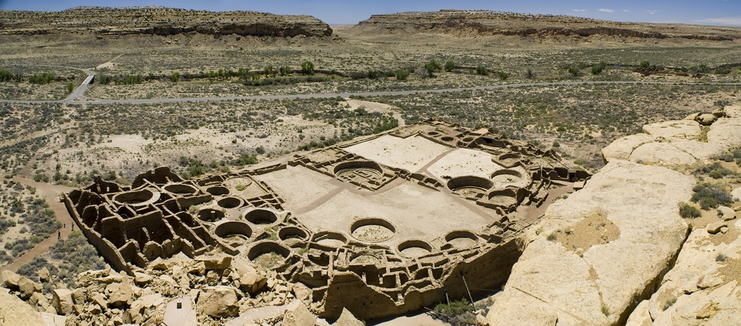
The Anasazi were able to build large urban settlements and to develop industry and innovative agriculture

Slide 21
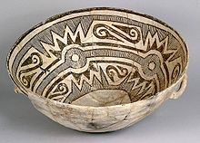
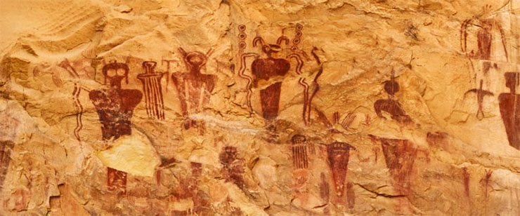
They built houses using complex construction methods, developing pottery and writing elaborate pictographs

Slide 22
But the Anasazi society failed
Drought, in spite of a highly sophisticated irrigation system
Deforestation is the main candidate for the ignition of the crisis
But also a social context: much work and social subordination was required for the extent of “public works” we verify as buildings; wars and scarce resources created further contradictions and conflict
The Anasazi left their homes and migrated south

Slide 23
Limits to growth 2
Social conditions
(some examples, to be continued in the next lectures)

Slide 24
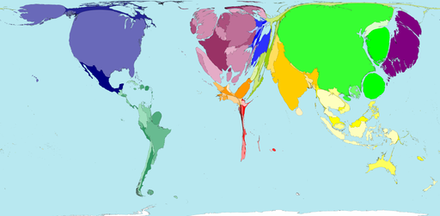
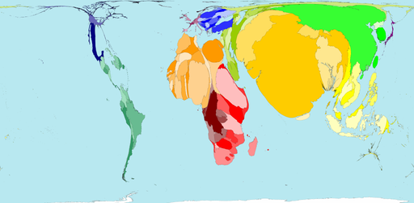
Wealth and poverty (World)
Wealth by country as compared to the world average (2015)
Poverty by country as compared to the world average (2003)

Slide 25
So, growth may be a problem
Societies and their economies express contradictions and social tensions (distribution and property issues)
Poverty, wealth or education inequality (or inequality in the access to other means of living), exploitation of resources, conditions of work, and rentism may affect the evolution of the economies: growth may be unequal, uneven and unfair

Slide 26
Limits to growth 3
Technology

Slide 27
Limits to growth debate
Meadows report (1972, MIT team): absolute limits to growth given the impact of production, food scarcity and pollution. Until 2070, a collapse will occur:
“If the present growth trends in world population, industrialisation, pollution, food production, and resource depletion continue unchanged, the limits to growth on this planet will be reached sometime within the next one hundred years.”
Reply by Chris Freeman and the SPRU team (Sussex, UK): technology is a social choice and may be used to create alternatives against depletion of natural resources (if the social conditions are met)

Slide 28
More limits to growth
The Big questions for the 21st century?
Climate Change: scarcity of water and energy? Some regions and cities will be depopulated?
A new pattern of inequality: availability of common goods (water), uneven access to public goods (security)?

